Slide 1
“Project Title”
Esaa Yamini, Juan Sebastian galindo , Avantika singh, Darren lucca, tommy ringo

Slide 2
Motivation/Questions

Slide 3

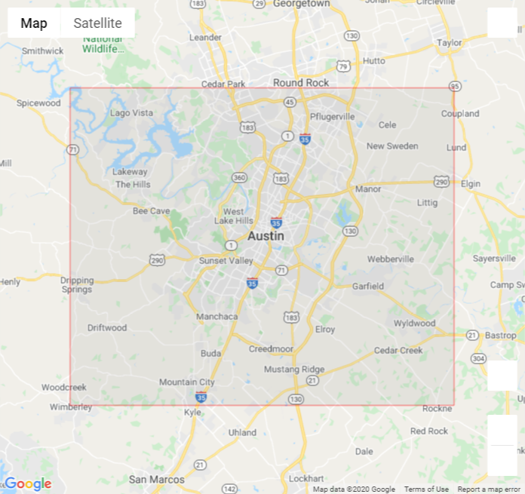
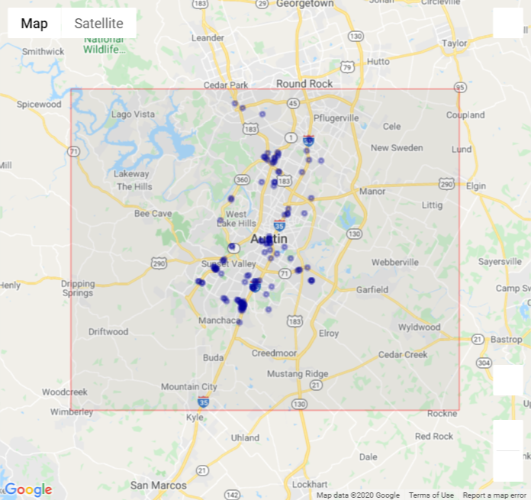
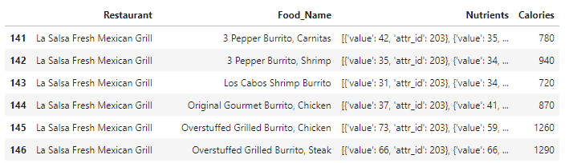
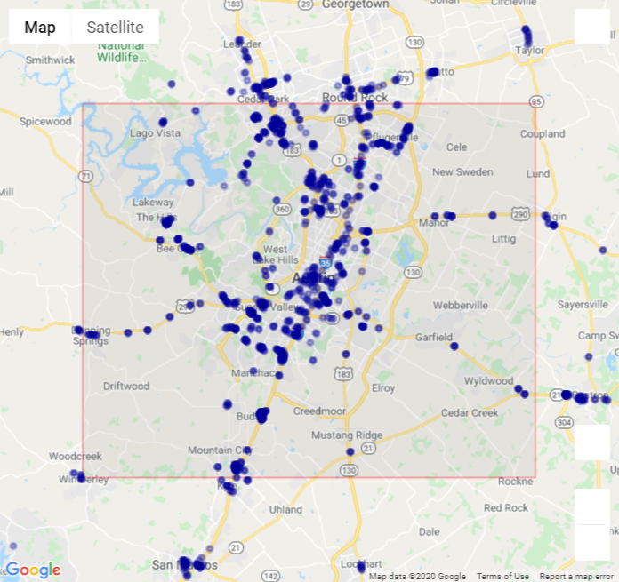
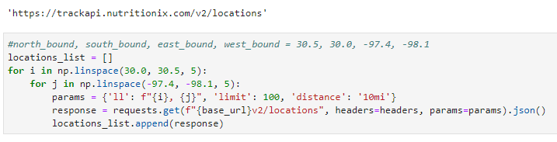
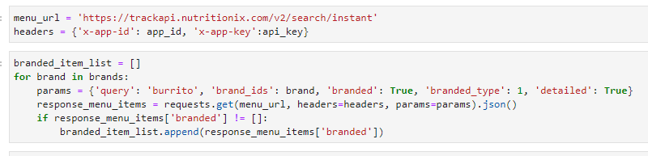
Data Retrieval
Set Boundary
API query for restaurant locations
Filter to unique locations in city
API query for nutrition details
121 locations
Location Query
Nutrition Query
1,433 locations

Slide 4
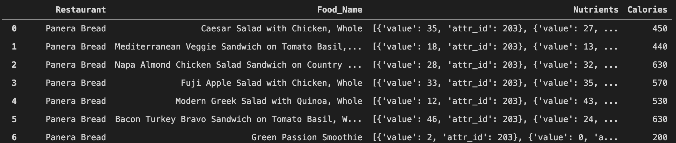
Data Processing

Slide 5
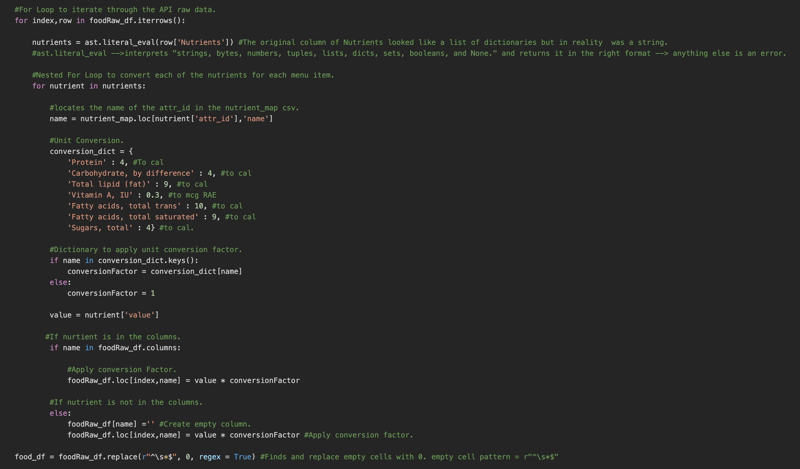
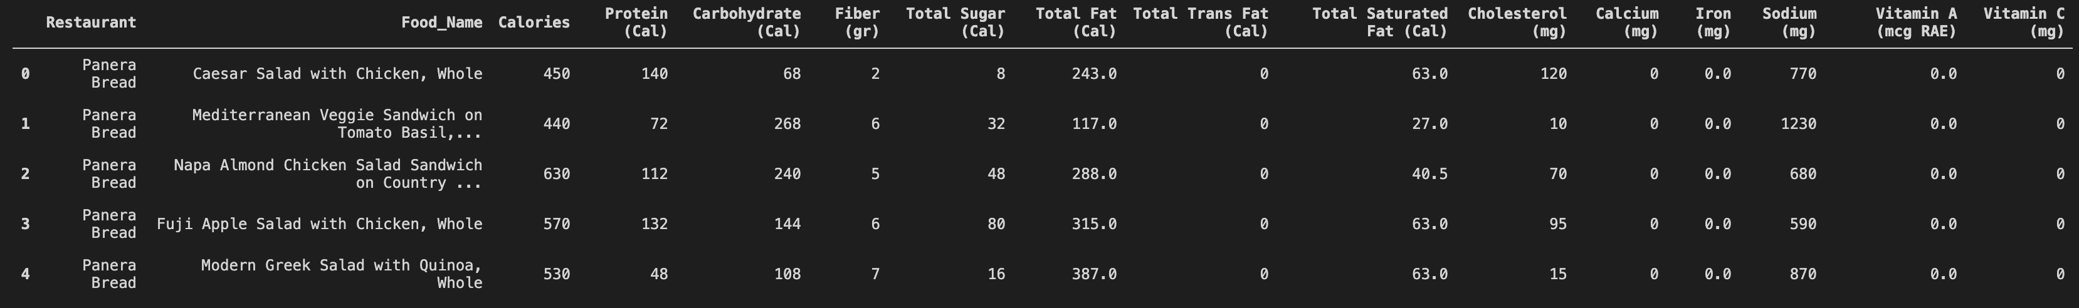

Slide 6
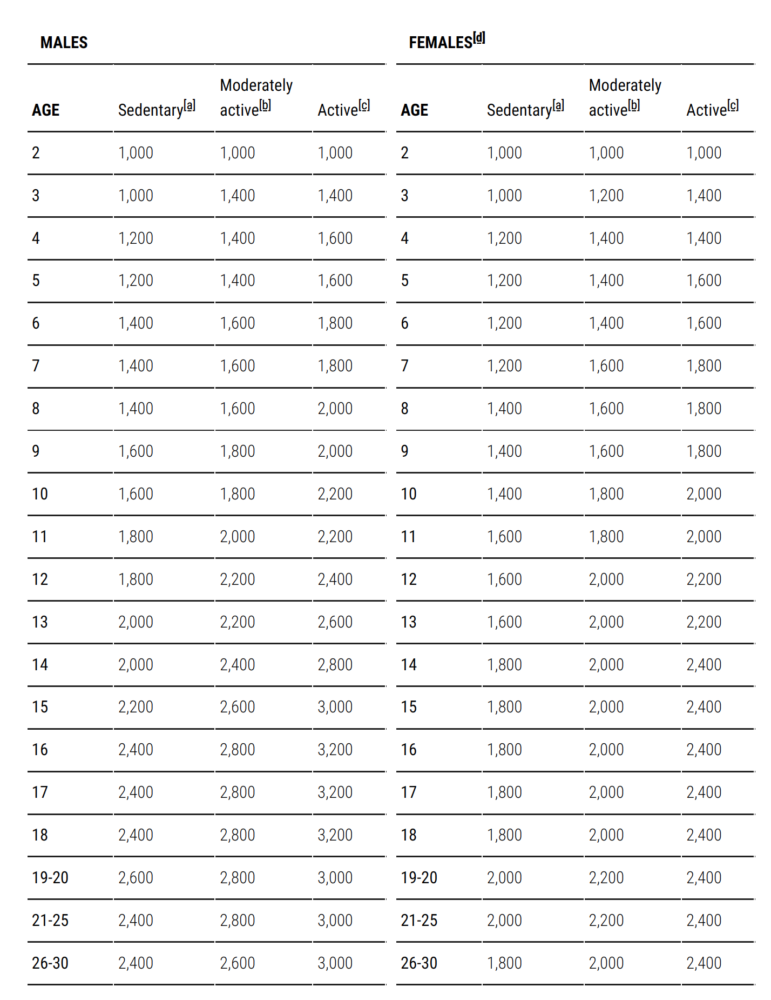
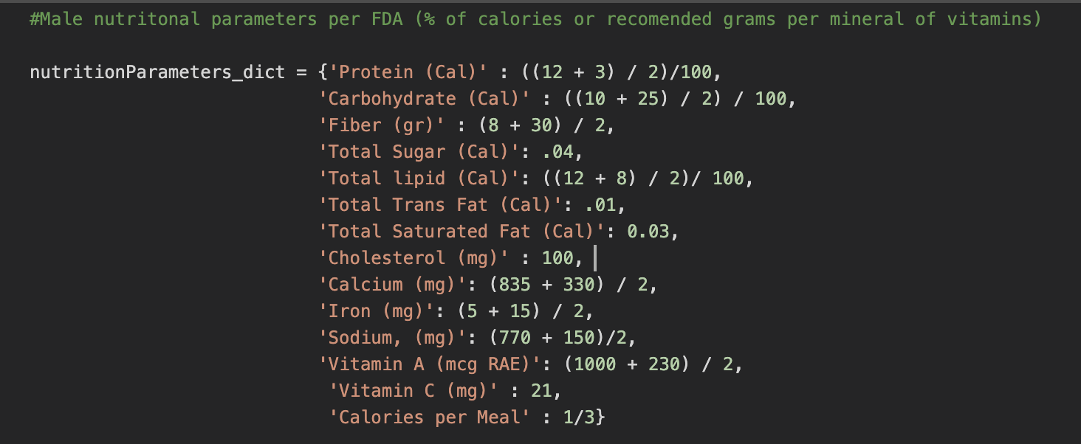

Slide 7
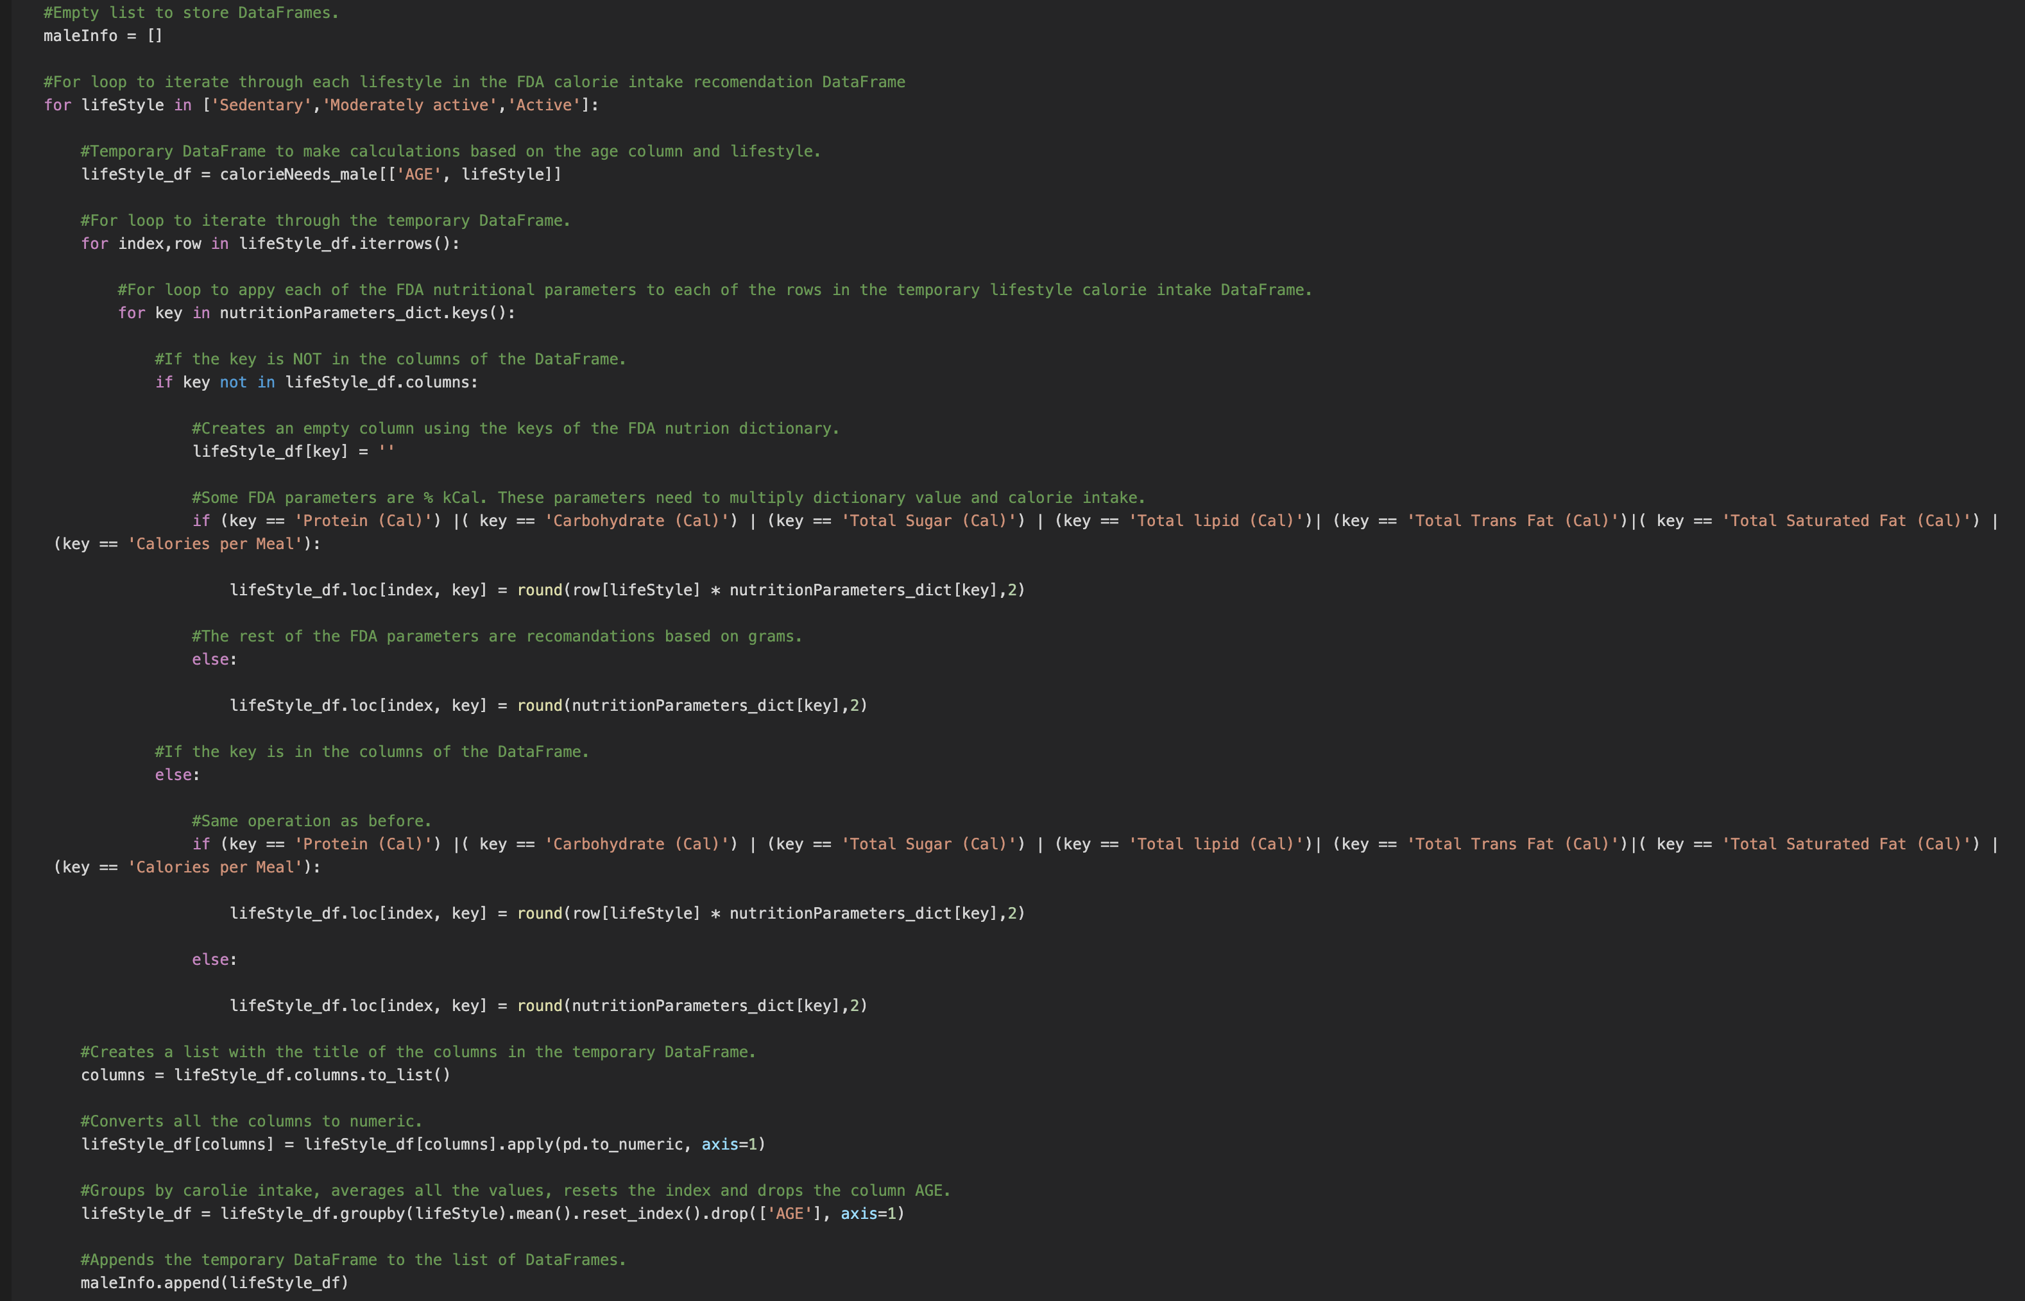

Slide 8
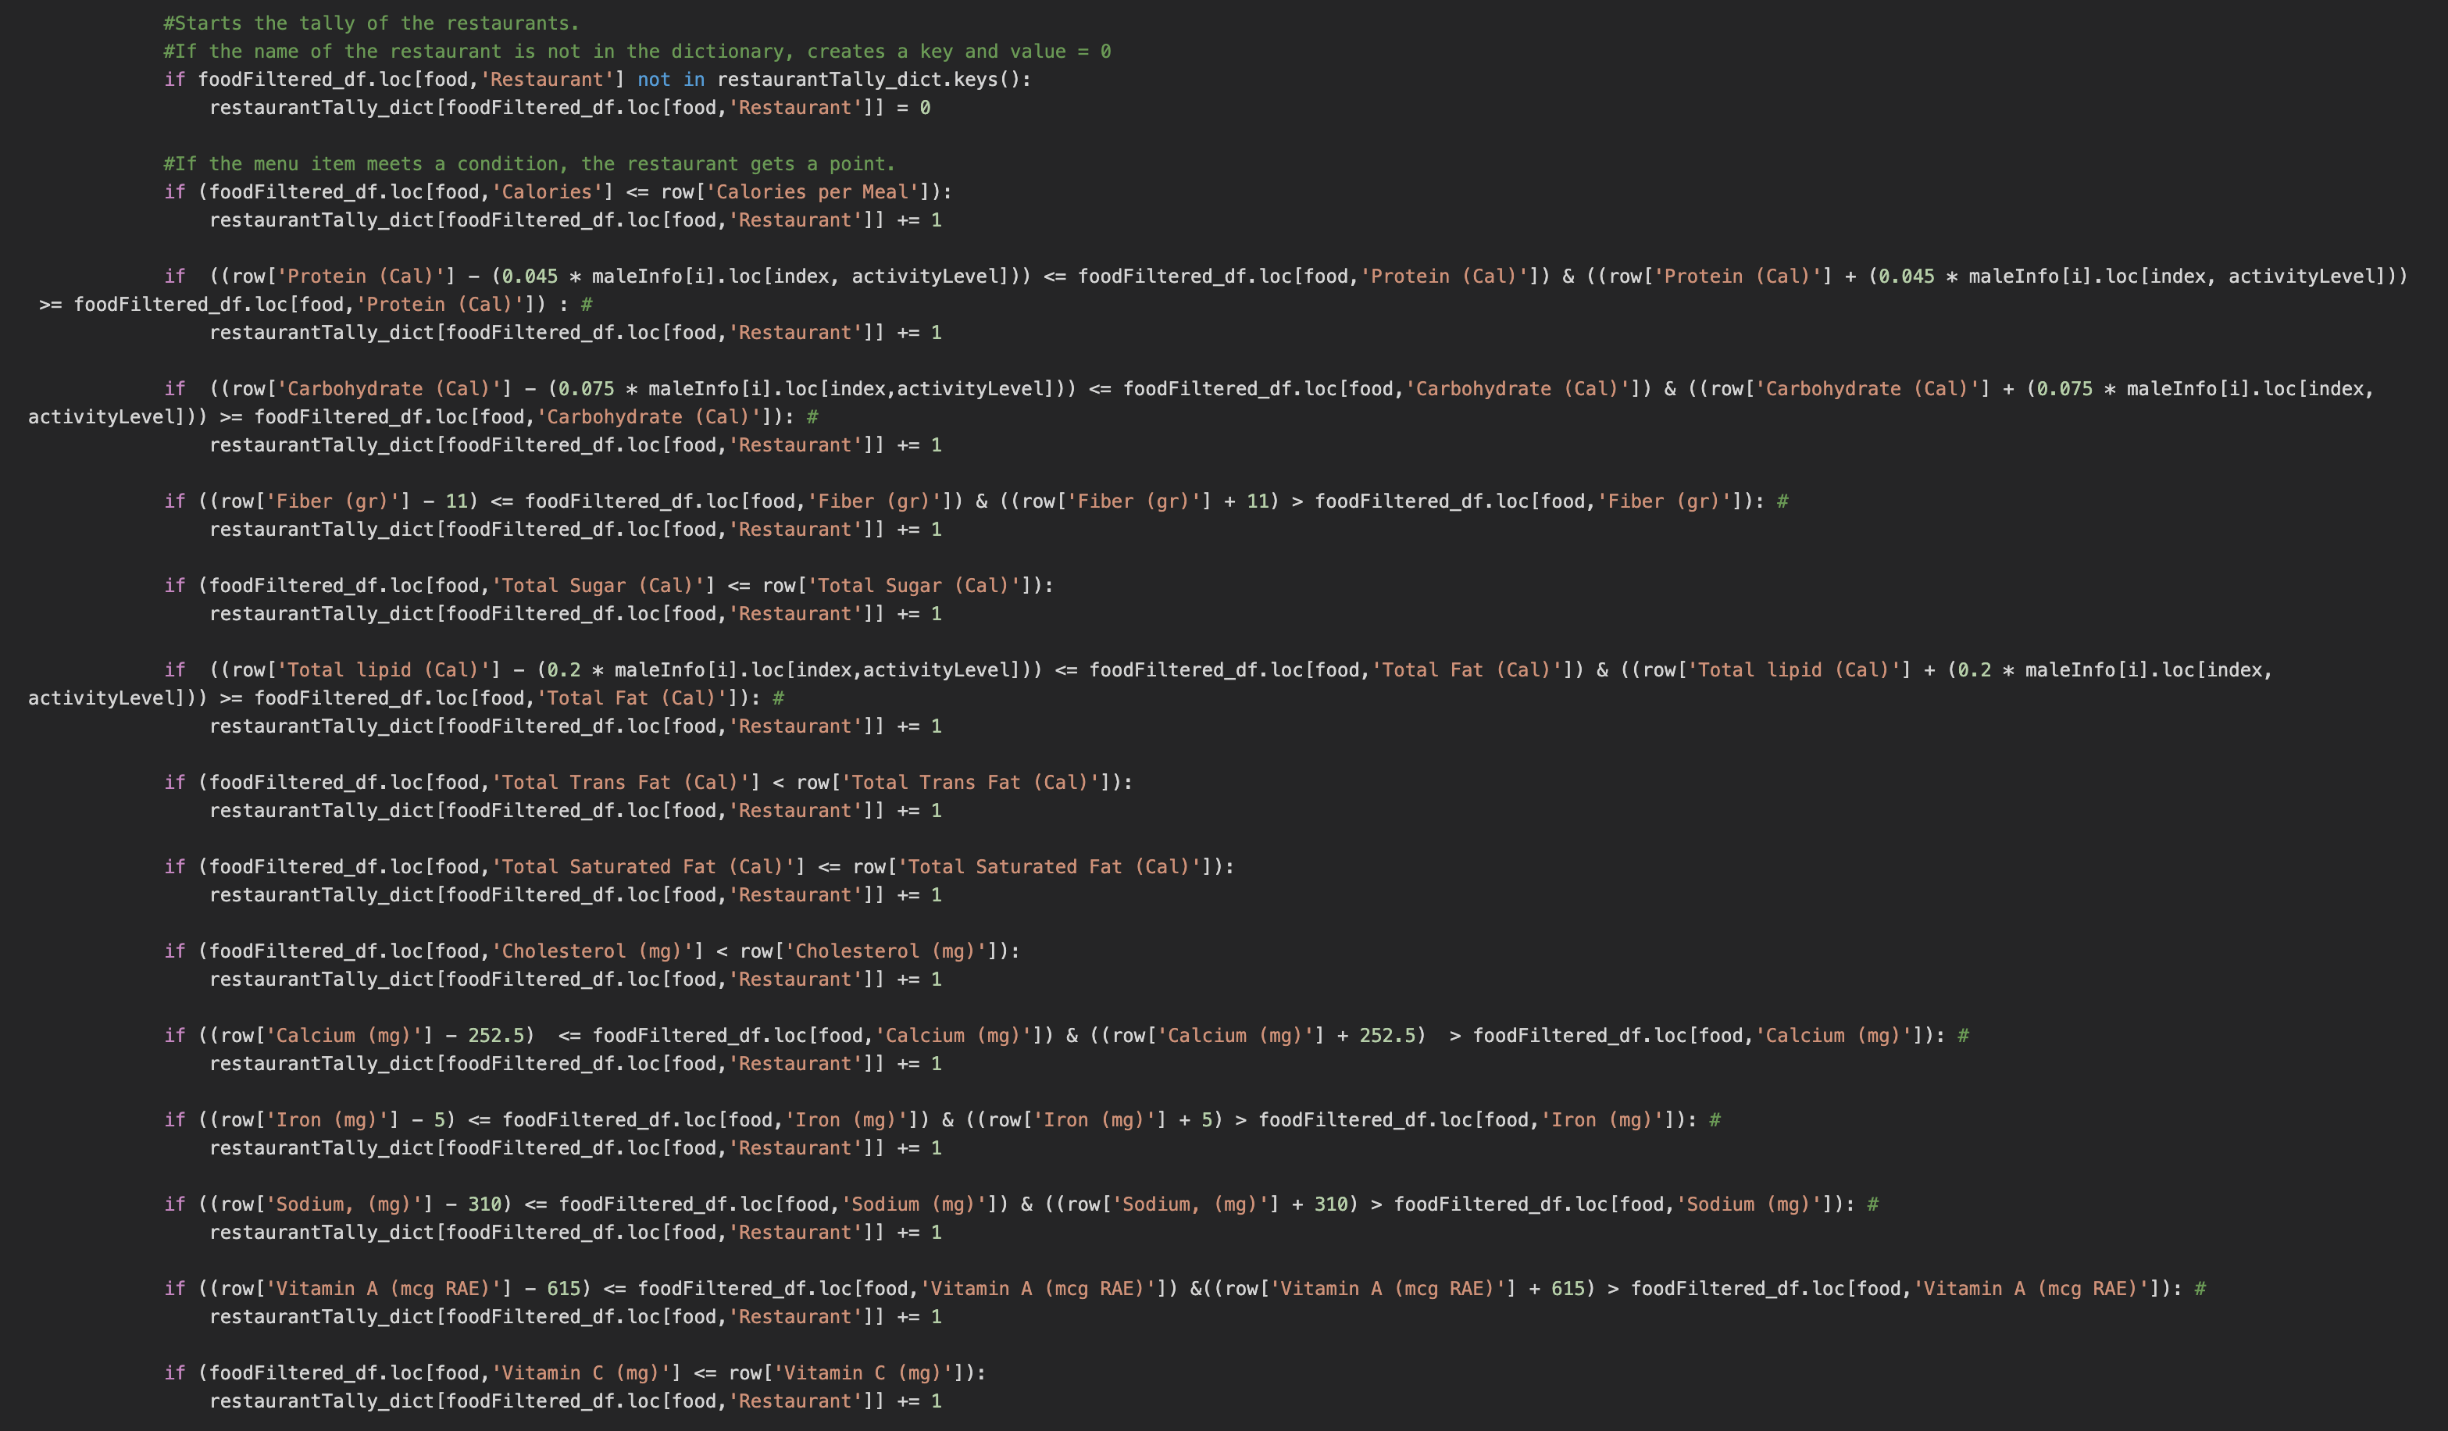

Slide 9
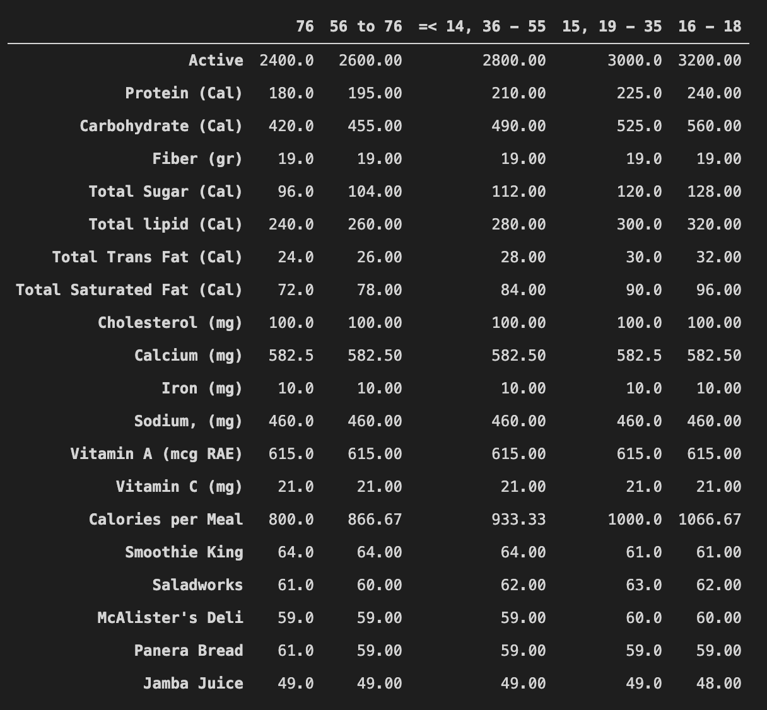

Slide 10
Analysis

Slide 11
Conclusions

